Slide 1
GYMPaG APR A Patch Generator, Ranker and Classifier For Java
George Cherian (UNI: gc2920)
Mavis Athene Chen (UNI: mu2288)
Yin Zhang (UNI: yz4053)

Slide 2


Our goal was to create an APR tool which could create a Patch which IS RANKED AND CLASSIFIED AS CORRECT
Our aim was to create a tool which solved more bugs than existing tools
We wanted to generate a ranking mechanism to rank patches in a suitable manner
We also wanted to create a classifier to determine if a patch was correct
Through all the above methods we wanted to save developer time spent conducting bug patches

Slide 3

The tool we built has 5 main Components
Fault localization
APR techniques
Output standardization
Patch Ranking
Patch Classifier

Slide 4

WE built an orchestrator to run the entire tool which takes in the following as INPUT
Bug Name
Classpath/Dependencies for the bug
Source code
Junit Test cases
Class files for source code
Class file for Junit test cases

Slide 5
Once the orchestrator is passed the input it proceeds to run the tool based on the diagram below
Cardumen
Input
Fault Localization
ARJA
Output Format Standardization
Ranking
Correctness Classifier
jGenProg

Slide 6
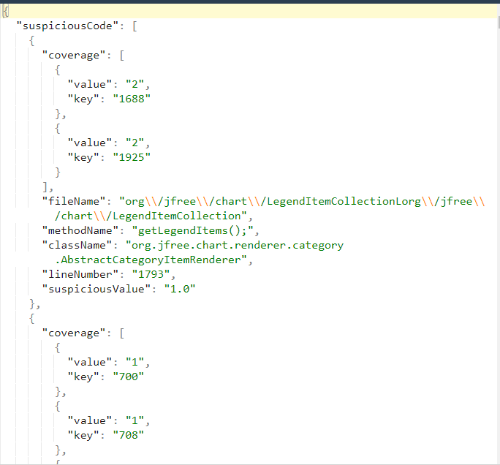
We MODIFIED all three techniques to use a common fault localization input
We used Gzoltar fault localization
We generated a JSON file containing all the suspicious statements
The output on the left is for the Defects4J Chart #1 bug and it is the example used through the rest of the presentation

Slide 7
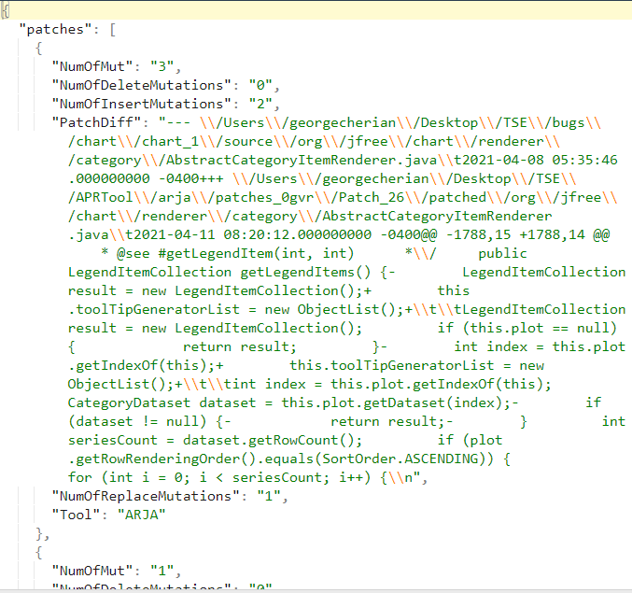
Once fault localization is done, we called all three techniques to run in parallel to generate patches
We use the JSON created by fault localization as an input to all three techniques
We modified the code bases for all three techniques to pass necessary information to the final layer
The final layer converts the output of all three tools into a standardized json which contains metrics for ranking, tool name and Patch difference

Slide 8
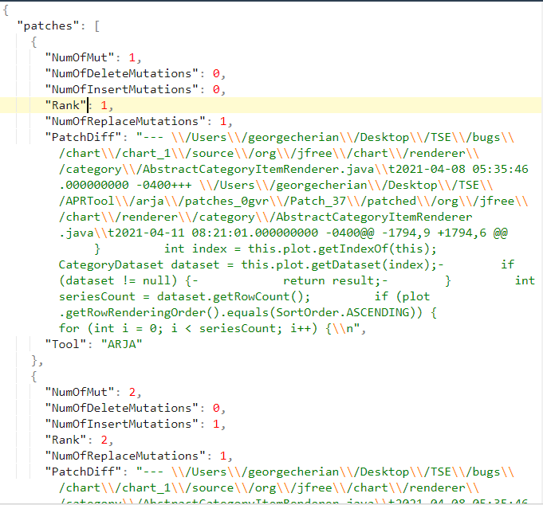
When all three tools are done executing then the Ranking mechanism is called
The ranking mechanism generates a rank for each of the patches created by the previous step

Slide 9
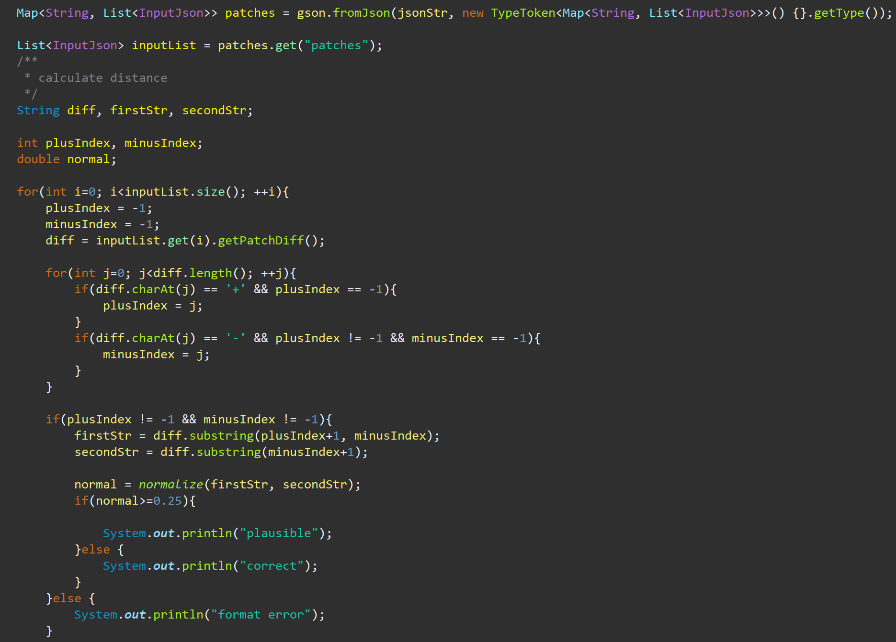
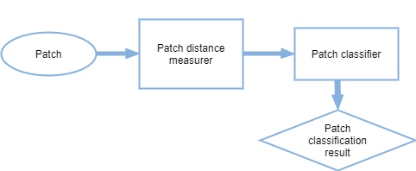
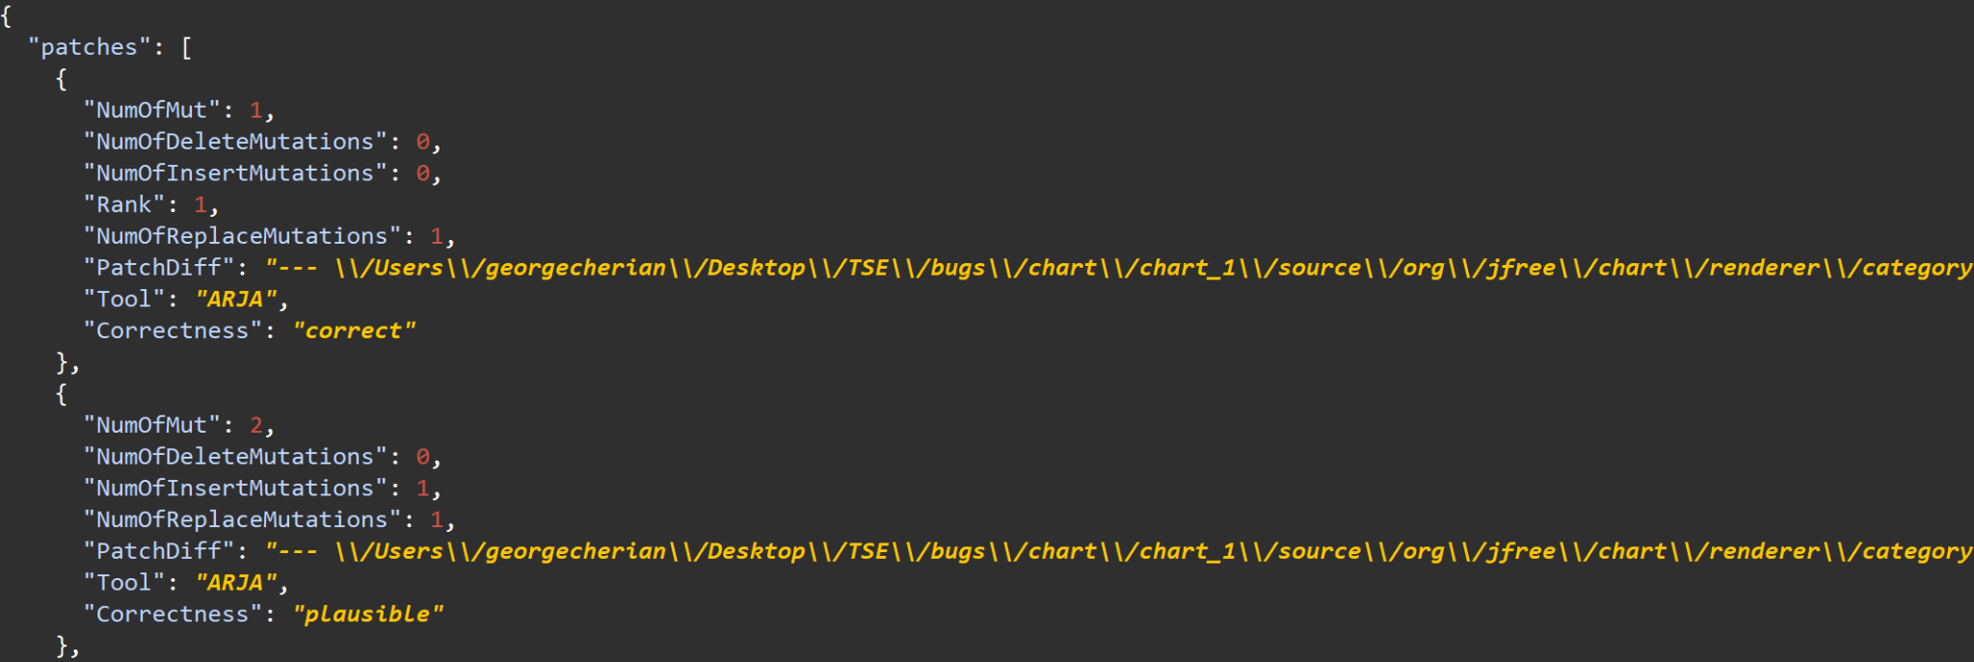
THE CLASSIFIER IS THEN CALLED WHICH GENERATES AN IDENTIFIER ON WHETHER THE PATCH IS CORRECT VS PLAUSIBLE
Approach Overview
PATCH-SIM: After a correct patch is applied, a passing test usually behaves similarly as before
Patch distance measurer:
distance(a, b) = 1 - |LCS(a, b)|
max(|a|, |b|)
Patch classifier:
classification{p) = plausible Ap ≥ Kp
correct otherwise
Result:
"Correctness" : "plausible" / "correct"
[1] Identifying patch correctness in test-based program repair
Notes:
Identifying patch correctness in test-based program repair
https://dl.acm.org/doi/pdf/10.1145/3180155.3180182

Slide 10

EXPERIMENT AND CODE DETAILS
We created a publicly accessible git repo containing the code: https://github.com/TeamAPR/tool
We ran a set of experiments using our tool on the Defects4J Chart Library
The results for the experiments are in the folders marked Chart_BUGNUMBER
We also ran 4 other APR tools as a comparison set on the Defects4J chart library
We ran the code on an M1 Mac with 16GB of RAM and a 1 TB SSD

Slide 11
Number of Bugs Fixed per tool

Slide 12
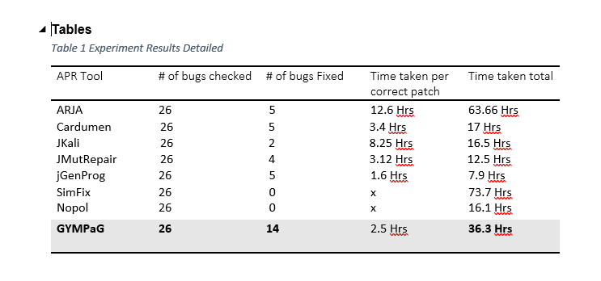
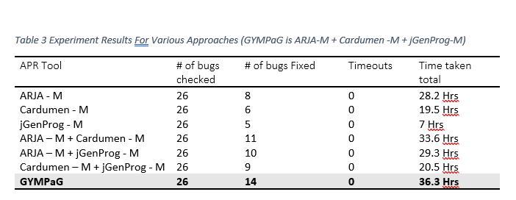
The tool took around 2.5 hours per correct patch which is faster than every other tool except JGenProg

